Slide 1
GROUP-12
TOPIC:
HUMAN ACTIVITY RECOGNITION WITH PCA

Slide 2
TEAM MEMBERS:
SIVA ADITYA:CB.SC.U4AIE24126
SIDDARTH SANKAR:CB.SC.U4AIE24151
AADIJITH:CB.SC.U4AIE24113
KAMALESH:CB.SC.U4AIE24121

Slide 3
INTRODUCTION
Human Activity Recognition (HAR): Identifies activities like walking, running, and sitting using sensor data.
Challenges: High-dimensional data, computational complexity, and noise.
Principal Component Analysis (PCA): A technique for reducing dimensionality while preserving key features.
Benefits of PCA in HAR:
Reduces computational load.
Removes redundant and less informative data.
Improves classification accuracy.
Enhances real-time processing efficiency

Slide 4
Principal Component Analysis(PCA)
Having too many features in data can cause problems like overfitting (good on training data but poor on new data), slower computation, and lower accuracy. This is called the curse of dimensionality, where more features exponentially increase the data needed for reliable results.
The explosion of feature combinations makes sampling harder In high-dimensional data and tasks like clustering or classification more complex and slower.
To tackle this problem, we use Feature engineering Techniques ,such as feature selection (choosing the most important features) and feature extraction (creating new features from the original ones). One popular feature extraction method is dimensionality reduction, which reduces the number of features while keeping as much important information as possible.
One of the most widely used dimensionality reduction techniques is Principal Component Analysis (PCA).

Slide 5
Convolutional Neural Network(CNN) and Long short-term memory(LSTM)
A convolutional neural network (CNN) is a type of artificial neural network that uses deep learning to identify patterns in data. CNNs are often used to identify objects, classes, and categories in images. They can also be used to classify audio, time-series, and signal data.
Long short-term memory (LSTM) is a type of recurrent neural network (RNN) that can process and remember information over multiple time steps. LSTMs are designed to handle long-term and short-term memory, and are used in a variety of applications, including speech recognition, language modeling, and sentiment analysis.

Slide 6
What’s the use of computing in this
Computing in HAR with PCA is essential for:
Data Handling: Collecting, storing, and processing sensor data.
Machine Learning: Running classification algorithms efficiently.
PCA Computation: Performing matrix operations for dimensionality reduction.
Real-Time Processing: Enabling quick decision-making in applications.
System Integration: Using software (Python, MATLAB) and hardware (GPUs, IoT).

Slide 7
ADVANTAGES
Advantages of HAR with PCA
Reduces Dimensionality: Simplifies high-dimensional sensor data.
Improves Efficiency: Speeds up processing and reduces computation time.
Enhances Accuracy: Removes redundant features, improving classification performance.
Minimizes Overfitting: Reduces noise, leading to better generalization.
Optimizes Storage: Decreases data size, making storage and transmission easier.

Slide 8
LIMITATIONS and DISADVANTAGES
Limitations of HAR with PCA
Loss of Information: Some valuable data may be lost during dimensionality reduction.
Computational Overhead: PCA requires matrix operations, which can be resource-intensive.
Dependence on Feature Variance: PCA assumes the most important features have the highest variance, which may not always be true.
Limited Adaptability: PCA-based models may struggle with unseen activities or variations in sensor data.
Not Ideal for Non-Linear Data: PCA is a linear method and may not capture complex activity patterns effectively.

Slide 9
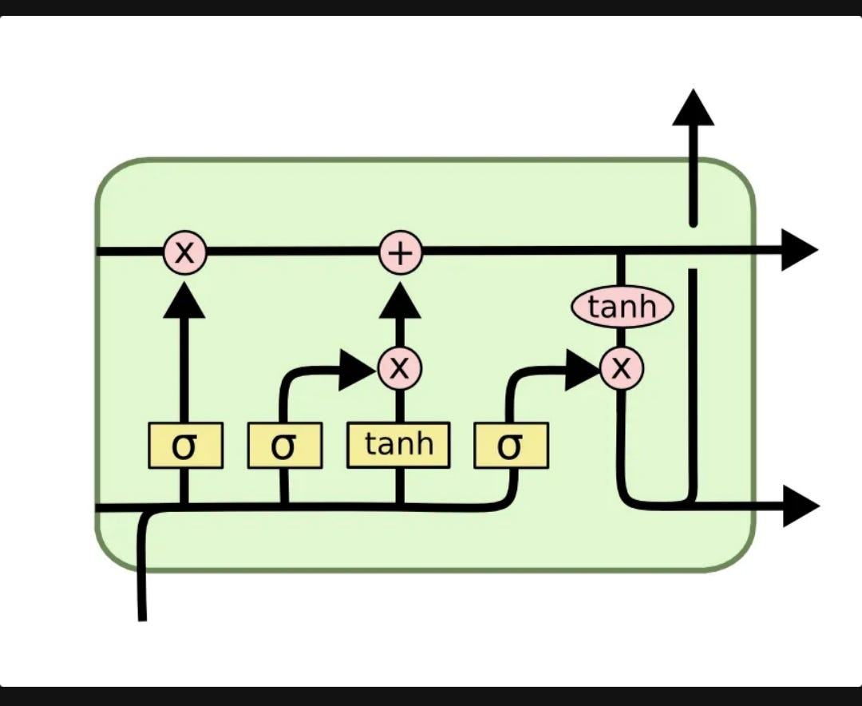
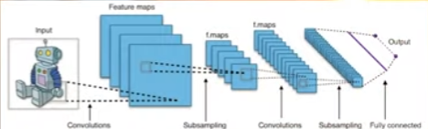
CNN
LSTM

Slide 10
LITERATURE REVIEW
Reference | Year | Methodology | Novelty
Human Activity Recognition Using A Hybrid CNN-LSTM Deep Neural Network | 2021 | CNN for feature extraction, LSTM for sequential modeling, PCA for dimensionality reduction | Hybrid model combining CNN, LSTM, and PCA for improved accuracy
Multi-Sensor Data Fusion and CNN-LSTM Model for Human Activity Recognition System | 2022 | Stacked CNN-LSTM with PCA for sensor-based HAR | Introduces an adaptive PCA technique for dynamic feature selection
Human Activity Recognition Based on Deep Learning and Micro-Doppler Radar Data | 2023 | Multi-layer CNN followed by Bi-LSTM, PCA for redundancy removal | Novel fusion of bidirectional LSTM and deep CNN for feature extraction

Slide 11
Reference | Advantages | Metrics | Limitations | Future Scope
Human Activity Recognition Using A Hybrid CNN-LSTM Deep Neural Network | Reduces feature space with PCA, enhances temporal pattern learning with LSTM | Accuracy, Precision, Recall, F1-score | High computational cost, requires large datasets | Optimize computational efficiency, explore real-time applications
Multi-Sensor Data Fusion and CNN-LSTM Model for Human Activity Recognition System | Improves feature representation, reduces overfitting | Accuracy, Sensitivity, Specificity | Limited generalization to unseen activities | Extend to multi-modal sensor fusion, enhance robustness
Human Activity Recognition Based on Deep Learning and Micro-Doppler Radar | Better sequential learning, handles long-term dependencies | Accuracy, ROC-AUC, Loss function | Increased complexity, needs extensive hyperparameter tuning | Implement lightweight models for edge devices, real-world testing

Slide 12
REAL TIME APPLICATIONS
Real-Time Applications of HAR with PCA
Healthcare & Elderly Monitoring: Detects falls, tracks physical activity, and monitors patient movements.
Smart Wearables: Fitness trackers and smartwatches use HAR for activity recognition.
Sports Analytics: Analyzes athlete movements to improve performance.
Security & Surveillance: Identifies suspicious activities in public spaces.
Human-Computer Interaction: Enhances gesture recognition in virtual reality (VR) and gaming.

Slide 13
OBJECTIVE
Objective of HAR with PCA
To recognize human activities (e.g., walking, running, sitting) using sensor data.
To reduce data dimensionality while preserving essential activity-related features.
To improve computational efficiency by minimizing processing time and storage needs.
To enhance classification accuracy by removing redundant and noisy data.
To enable real-time processing for applications like healthcare, smart wearables, and security.
To develop a robust HAR system that generalizes well across different users and environments

Slide 14
Proposed method
Hybrid Approach: Use PCA for dimensionality reduction, followed by Machine Learning Classifiers (e.g., SVM, k-NN) for activity classification.
Why This Method:
Efficiency: Reduces data size, speeding up processing and saving storage.
Better Accuracy: Removes redundant features, improving classifier performance.
Real-Time Capability: PCA allows quicker decision-making for real-time applications.
Flexibility: Adapts well to various HAR tasks, enhancing robustness.
Mitigates PCA Limits: Combines PCA with classifiers to retain essential features and improve accuracy

Slide 15
Methodology
1. Data Collection :
Use UCI HAR and iSPL datasets from wearable sensors (accelerometer, gyroscope).
2. Data Preprocessing :
Clean & normalize data.
Apply PCA to reduce feature dimensions while preserving 95% variance.
Reshape into (samples, timesteps, features) for CNN-LSTM input.
3. Model Design (CNN-LSTM with PCA) :
CNN extracts spatial features.
LSTM captures temporal dependencies in activity patterns.
Dense + Softmax layers classify activities.
4. Model Training :
Train with Adam optimizer, categorical cross-entropy loss.
Split data (80% train, 20% test) with batch size 32, epochs 20.
5. Evaluation & Comparison :
Achieves 99% accuracy (iSPL) and 92% accuracy (UCI HAR).
Outperforms SVM, Random Forest, and other deep learning models.
6. Deployment & Future Work :
Optimize for real-time applications in mobile/wearable devices.
Explore Transformer models & data augmentation for improvements.

Slide 16
Human Action Recognition (HAR) Dataset
Dataset link: https://www.kaggle.com/datasets/arunasivapragasam/human-activity-recognition-dataset/data

Slide 17
Conclusion
This project successfully implements a CNN-LSTM model integrated with PCA for Human Activity Recognition (HAR) using sensor data from wearable devices. By leveraging CNN for spatial feature extraction and LSTM for temporal sequence learning, the model effectively classifies human activities with high accuracy. The addition of PCA optimizes the model by reducing dimensionality while preserving critical information, leading to improved computational efficiency.
Our proposed model achieves 99% accuracy on the iSPL dataset and 92% accuracy on the UCI HAR dataset, outperforming traditional machine learning approaches like SVM and Random Forest. The results demonstrate that deep learning-based HAR systems can provide robust and efficient solutions for real-world applications, including health monitoring, smart home automation, and fitness tracking.
Future improvements could focus on optimizing the model for real-time deployment on mobile and IoT devices, integrating Transformer architectures, and using data augmentation to enhance generalization across different users and environments. This research highlights the potential of deep learning in human behavior analysis and its application in next-generation smart systems.

